Slide 1



The Performance of an AI fund against Actively Managed Funds Question 1 Financial Econometrics Examination
Photo by Stefan Els

Slide 2
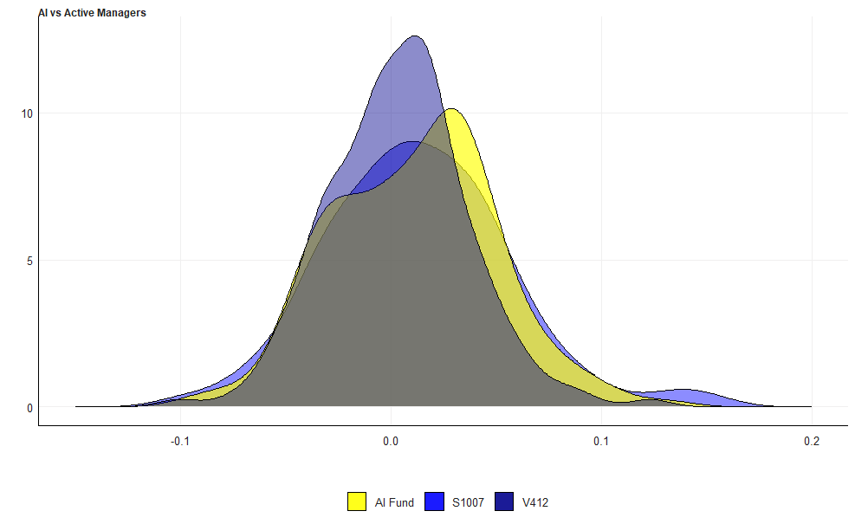
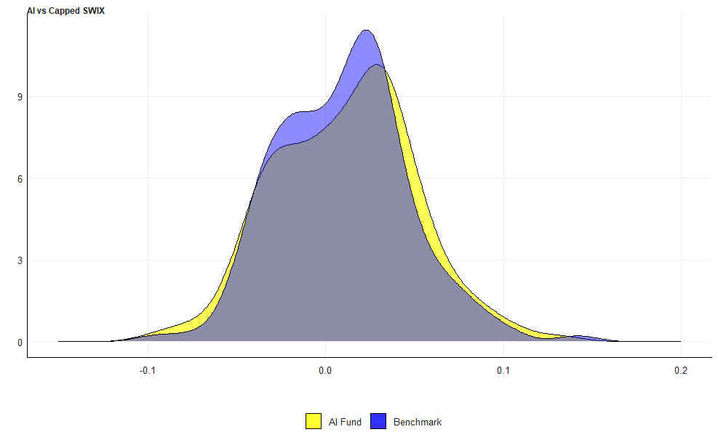
Distributions of Returns
Notes:
Note that consumers can either pay in store for gas or at the pump. Generally, if they are drawn in-store, they might end up buying other goods, which is more common to see when increases are not as high as what they expected.

Slide 3
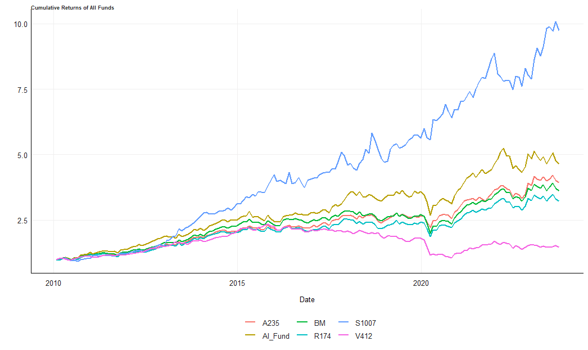
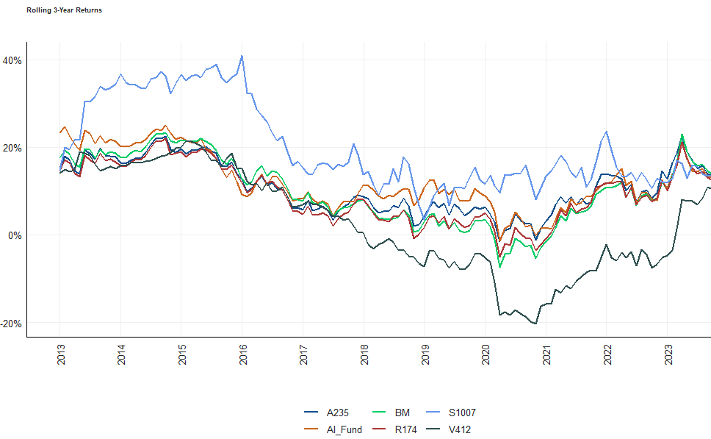
Returns

Slide 4
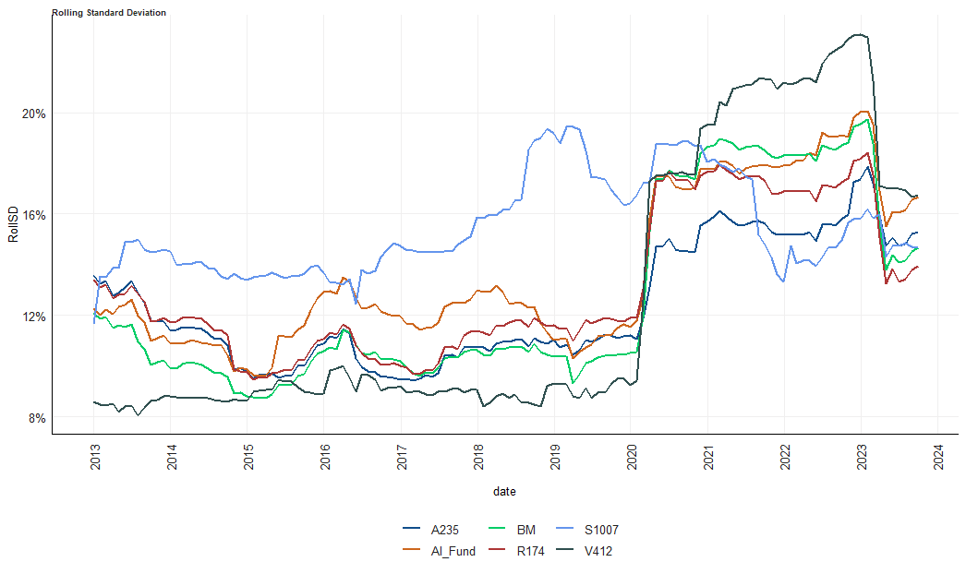
Rolling Standard Deviation

